Slide 1
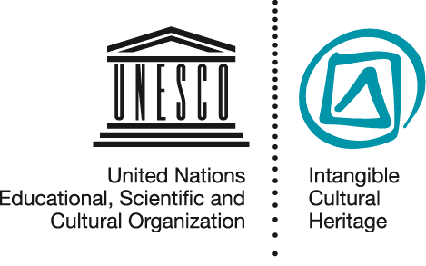
Implementing the Convention at the national level
RAT PPT 2.4
UNESCO
Intangible Cultural Heritage Section

Slide 2
In this presentation...
Obligations and recommendations for safeguarding
Legal and administrative context
Awareness-raising
Identifying, defining, inventorying
Safeguarding measures for specific elements

Slide 3
Safeguarding obligations
Each State Party shall …
Ensure the safeguarding of the ICH in its territory
Identify and define the ICH with the participation of relevant communities, groups and NGOs
Draw up and regularly update inventories of the ICH

Slide 4
Safeguarding recommendations
Adopt general policies
Create/designate institutions for safeguarding, training, management, documentation
Foster research
Ensure appropriate access
Ensure respect for ICH
Ensure community participation
Cooperate internationally
States Parties shall try (by all appropriate means) to ...

Slide 5
Safeguarding at the national level
Creating a broad legal and administrative context
Inventorying, identifying, defining ICH elements
Awareness-raising about value of ICH
Implementing specific measures to safeguard ICH elements

Slide 6
Legal and administrative context
Enhancing existing legislation, policies and institutions
Amending legislation and policies, creating institutions
Creating consultative bodies & cooperation mechanisms involving communities, NGOs, other stakeholders

Slide 7
Awareness-raising about ICH
Media campaigns
Educational programmes
Multimedia databases
Seminars and workshops

Slide 8
Identifying, defining and inventorying ICH
What is identifying, defining and inventorying ICH?

Slide 9
Identifying, defining and inventorying …
ICH in the territory of the State Party
With the participation of communities and NGOs
With a view to safeguarding
Respecting customary practices governing access
Building relationships

Slide 10
Examples of inventories
Venezuela
Brazil
Bulgaria
China
France
Fiji
Canada

Slide 11
Safeguarding the ICH
Supporting communities and groups to ensure continued practice and transmission
Based on an analysis of threats and risks, and the commitment of tradition bearers
Safeguarding measures may apply to specific ICH or be more general

Slide 12
The Voladores ceremony (Mexico)
© 2008, by Cumbre Tajin

Slide 13
Threats to viability - 1
The flight of the Voladores around the pole is the climax of the ceremony.
Increasingly only this part of the ceremony is performed, for tourists, outside the community context
© 2008, by Cumbre Tajin

Slide 14
Threats to viability - 2
Ritual preparations for the ceremony maintain its significance for the community.
Performance by professional dancers, especially for tourists, reduces focus on ritual aspects.
© 2008, by Cumbre Tajin

Slide 15
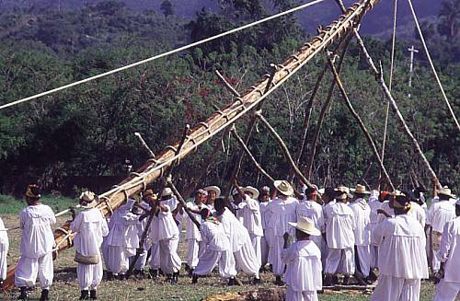
Threats to viability - 3
Poles for the ceremony were traditionally cut down in the forest and ritually prepared.
Too few appropriate trees, now using fixed metal poles
© 2008, by Cumbre Tajin

Slide 16
Voladores safeguarding measures
The measures, elaborated in meetings with Voladores groups and with State and NGO support, include:
Reforestation
Opportunities for performing the entire ceremony including ritual dimensions
Schools for Volador Children promoting transmission of knowledge & skills including ritual dimensions

Slide 17
Points to remember
States Parties to the Convention are obliged to inventory and safeguard the ICH on their territory with the participation of the communities concerned

